Slide 1

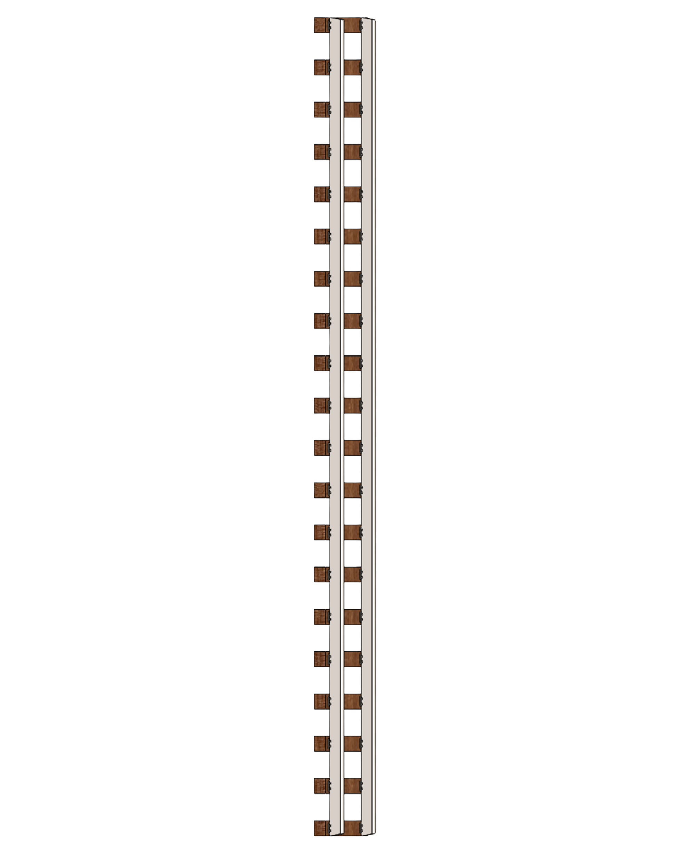

Slide 2

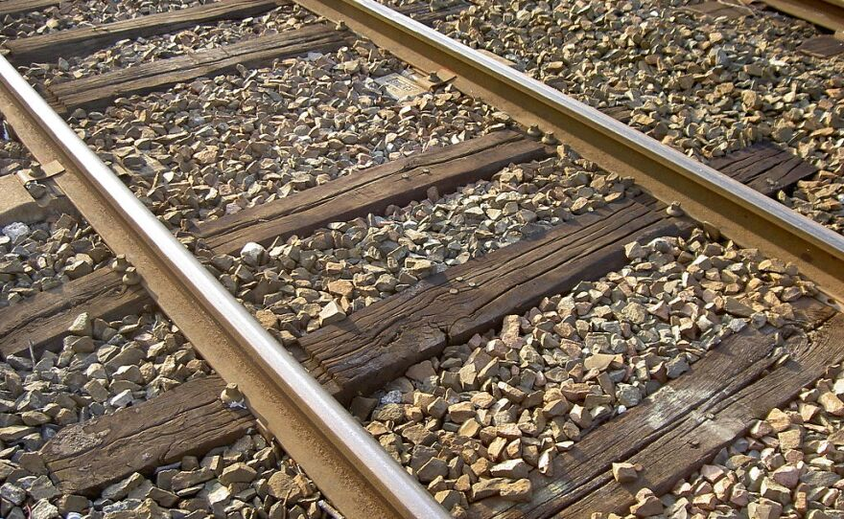
THE WOODEN RAILWAY TIE
Deforestation
20 Million trees cut annually for U.S Rails. $2B deforestation industry.
2. Wood rot
Ties rot and require replacement every 10 years
3. Cancer coating
Treated with creosote, a toxic preservative and carcinogen that seeps into soil and water supplies

Slide 3



Slide 4

THE TITAN
THE ENVIRONMENTAL ALTERNATIVE
Two birds, one stone
Polymer engineered from unrecycled #3,#6,#7 plastics, reducing both plastic waste and deforestation.
Durable
Lasts 50+ years (vs.10 for wood)
Cancer-free
No carcinogen chemicals seeping into soil and water supplies.

Slide 5
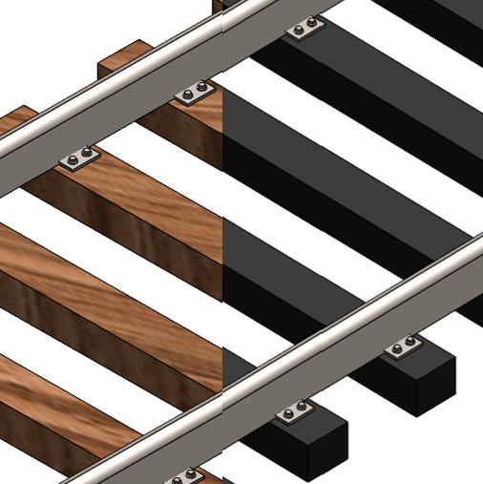



Agenda
Design/Fabrication
Scalability/Marketing
Timeline/Projection

Slide 6
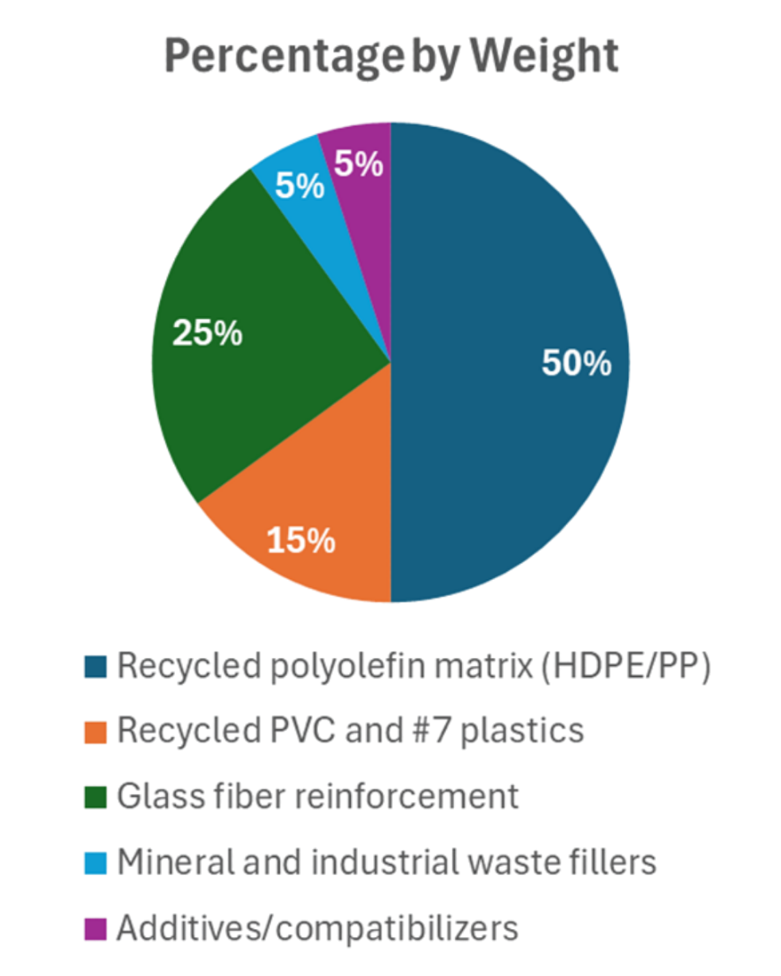
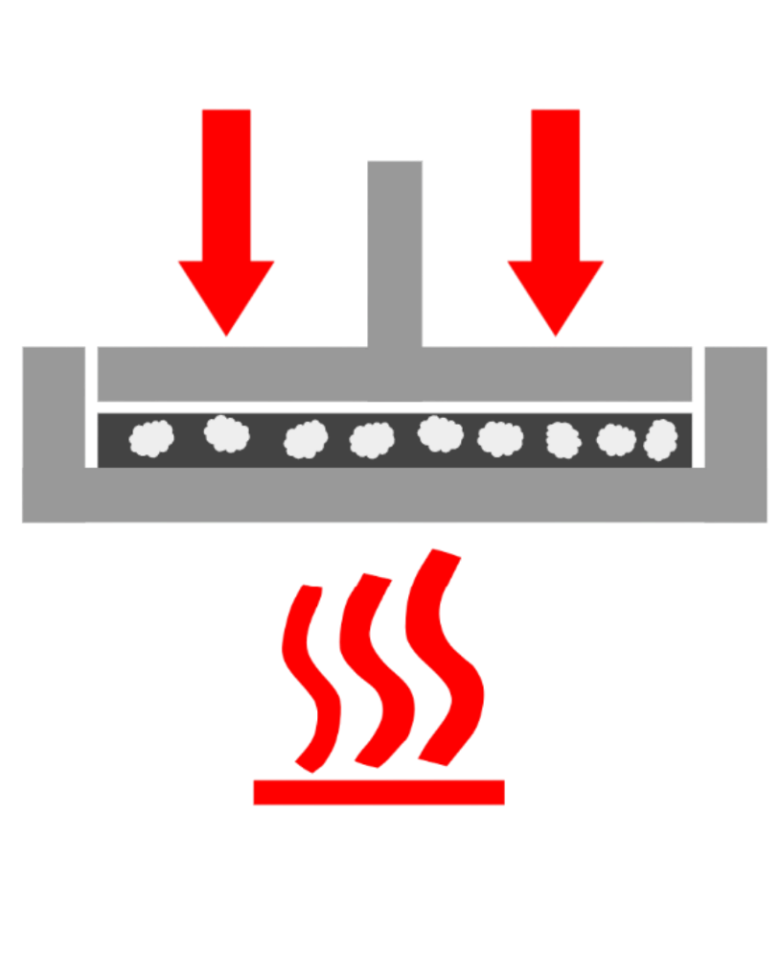
DESIGN/FABRICATION
Plastic sintering
Polymer fused via pressure and heat
15% PVC:85% other
Meets stress requirements
Meets impact resistance requirements
We take their plastic, they pay us
We partner with local Municipal recycling facilities, who source our composite materials

Slide 7
Scalability
20 million ties replaced a year
Idea:
Replace wood ties with composite during maintenance
400-450 million wood ties in the US
Ties replaced every 10 years
80-90% of ties full of Creosotes
Notes:
U.S. railroads replace around 20 million wood ties per year
Wood is roughly 80-90% of all ties in track, each mile using about 3200-3500 ties, 400-450 million ties are in use.
320-400 millions of those ties are creosote‑treated wood.
Idea: replace wood ties with composite during maintenance

Slide 8





Target audience
Railway Contractors & Infrastructure Companies
3rd Party Logistics
Government & Municipal Agencies

Slide 9
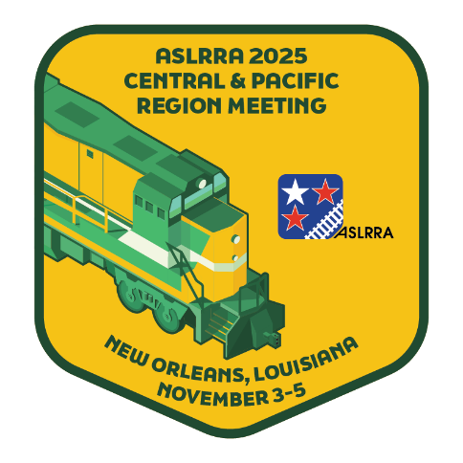

Why us?
 | 1 Wood Ties | 1 PolyRail Titan Tie
Price | $25 | $45
Replacement frequency | 10 Years | 50+ years
Cost over 50 years | $250 | $45
Marketing
Industry Conferences​
Social media​
Sales Team

Slide 10
Timeline
Year 1
Year 2
Year 3
Year 4
Year 5
Foundation & validation
Pilot & field testing
Texas expansion
Regional expansion
National expansion
Research and development
Finalize composite formulation
Ties sold: 0
Expand capabilities for increased production
Keep within Bryan - College Station, TX
Ties sold: 1.8K
First Factory
Pitch to Union Pacific & expand within TX
Ties sold: 18k
Scale production and logistics
Expand within Southern US
Ties sold: 90k
Expand deployments to railroad corridors
Develop next-generation composite formulation
Ties sold: 300k

Slide 11
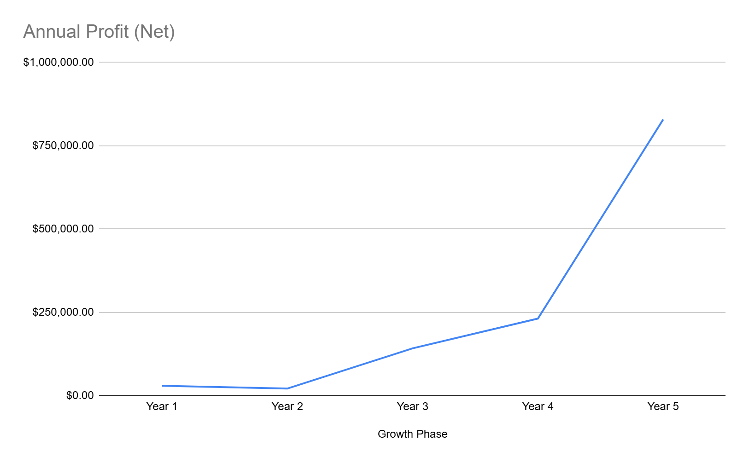
Projections
Costs
Raw Materials, Logistics, Labor, Operations, Legal/Insurance
Revenue
Selling ties, plastic buyback program
Grants
Aggie Pitch, EPA P2 Grant, College Station EDC Micro Grant

Slide 12
Future aspirations
Growth into international markets.
Reaching the undesirable plastics in countries with lacking infrastructure to properly recycle.
Expanding our scopes into other railway systems beyond the US borders, pushing our goal of impacting the environment further.

Slide 13
One tie at a time
Notes:
END OF SLIDES

Slide 14
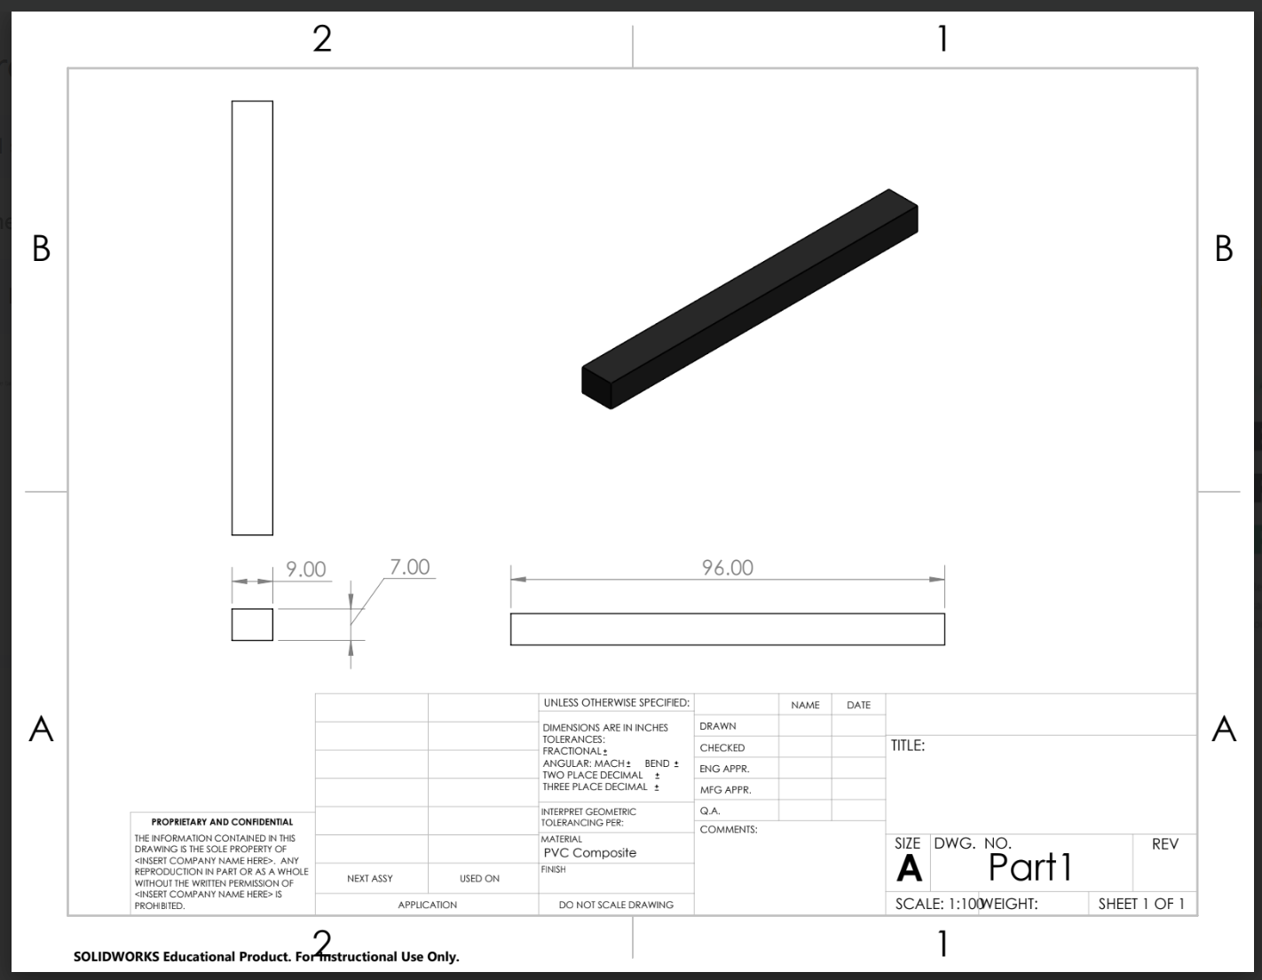
Notes:
SUPLEMENTAL MATERIAL

Slide 15
Cost
Item | Wood Ties | PolyRail Titan Ties
Upfront cost per tie | ~25 $ | 45 $
Service life (years) | 10 | 50+
Upfront cost per mile | 83,750 $ | 150,750 $
Cost of 1 tie per year | 2.5 $/yr | 0.9 $/yr
Cost of 1 mile per year | 8,375 $/yr | 3,015 $/yr
50‑year lifecycle cost per mile | 418,750 $ (5× replacement) | 150,750 $ (1 install)
Total savings over 50 years |  | 268,000 $ saved per mile
Notes:
SUPLEMENTAL MATERIAL

Slide 16
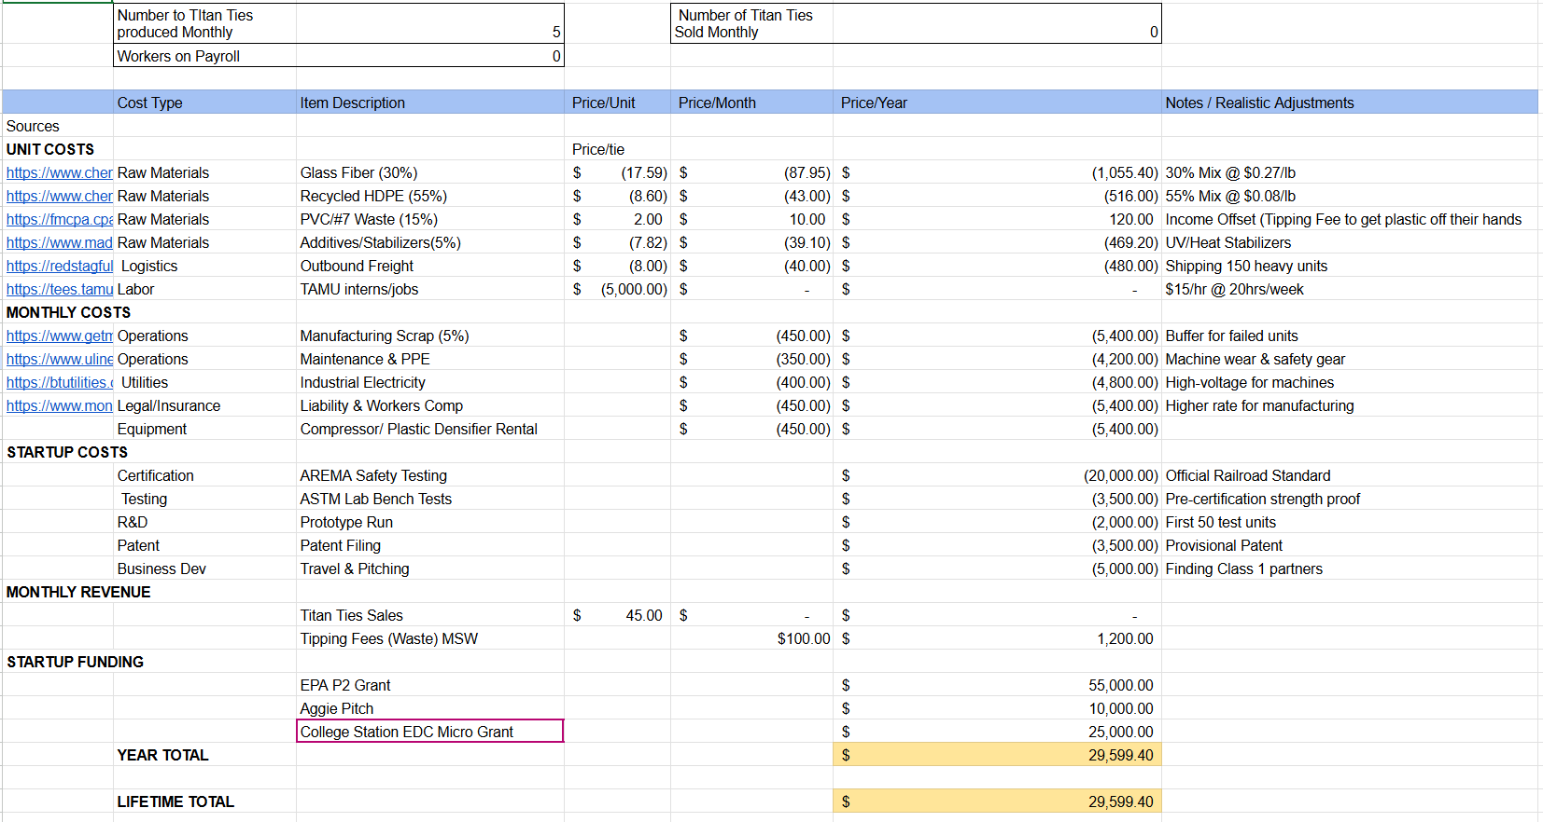
Year 1 Finances

Slide 17
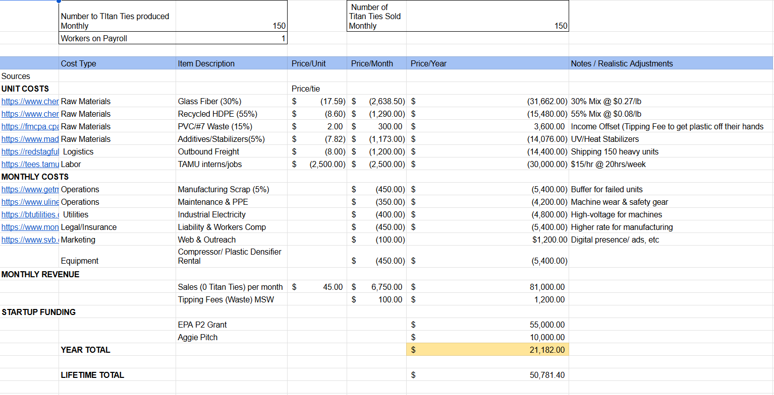
Year 2 Finances

Slide 18
